Slide 1

Information Technology Infrastructure Library
Presented by
Avtar Singh (20csu241)
Sunil Kharsu (20csu371)

Slide 2


Context
Services and Need for Services
ITIL
Service Life Cycle Stages
Service Strategy
Service Catalogue Management(SCM)
Service Transition
Service Validation and Testing
Continual Service Improvement
Devops Vs ITIL
Thank You

Slide 3

What are Services?
Services are resources or capabilities that facilitate the creation, delivery, or support of a product or service.
In ITIL, services are defined as the means of delivering value to customers by facilitating outcomes they want to achieve without the ownership of specific costs and risks.
Photo by Pixabay

Slide 4

Need of Services
Provide value to customers and stakeholders.
Businesses to meet their objectives by delivering outcomes.
Aligned with the needs of the customers.
Help businesses to remain relevant
Competitive
adaptable in changing Requirements.
Photo by Pixabay

Slide 5
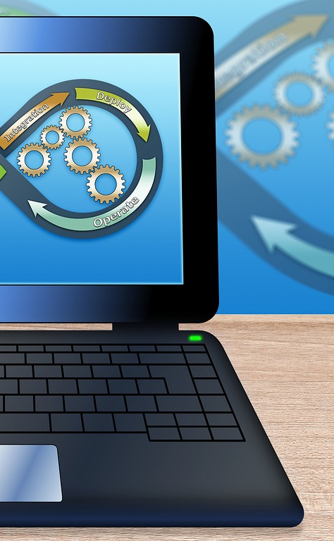
ITIL in Services
- ITIL is a framework that provides guidelines and best practices for managing IT services.
- It is a set of practices that helps organizations to align their IT services with the needs of the business, and to improve the quality of services they provide.
Photo by Pixabay

Slide 6
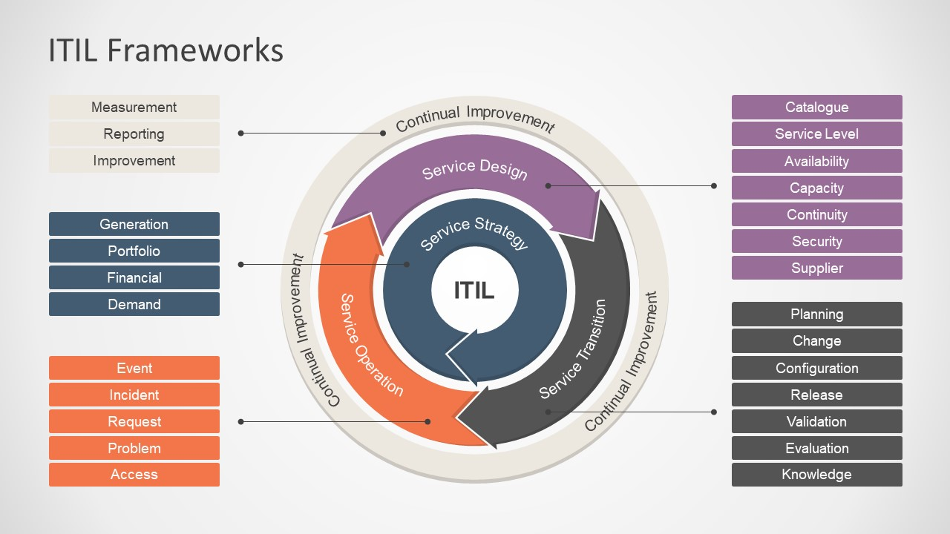

Slide 7

Life Cycle Stages
of Service
- It Comprising five stages:
Service Strategy
Service Design
Service Transition
Service Operation
Continual Service Improvement.
Photo by Pixabay

Slide 8

Service Strategy
- In this stage, the focus is on defining the business objectives and developing a strategy to deliver value to the customers.
- Key activities include :
service portfolio management,
demand management, and
financial management.
Photo by Pixabay

Slide 9

Why Service Strategy ?
Aligns IT services with business goals
﻿﻿﻿Provides a clear direction for service delivery
﻿﻿﻿Helps prioritize and manage resources
﻿﻿﻿Ensures consistent and high-quality service delivery
﻿﻿﻿Encourages innovation and continuous improvement.

Slide 10

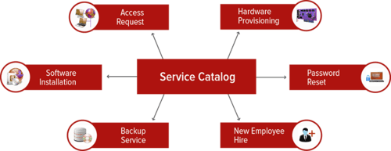
Service Catalogue Management (SCM)
- SCM is the process of managing the service catalog that lists all the services provided by IT.
- It helps customers to understand the services, their features, and the associated costs.
- Key activities include service catalog management and service level management.
Photo by Pixabay

Slide 11

Service Transition
- In this stage, the focus is on designing and transitioning new or changed services into production.
- Key activities include service asset and configuration management, release and deployment management, and change management.
Includes :
potential business value and who it is delivered to/judged by
﻿﻿identification of all stakeholders within supplier, customer and other areas
﻿﻿application and adaptation of service design, including arranging for modification of the design, where the need is detected during transition.
Photo by Pixabay

Slide 12

Change Management
Change Management ensures that changes are recorded, evaluated, authorized, prioritized, planned, tested, implemented, documented and reviewed in a controlled manner.
The purpose of the Change Management :
Ensure that standardized methods are used for the efficient and prompt handling of all changes.
The process addresses all service change.

Slide 13

Service Validation and Testing
- Service Validation and Testing ensures that a new or changed service meets the requirements and performs as expected before it is released into production.
- Key activities include service validation, service testing, and service acceptance.
Photo by Pixabay

Slide 14

Continual Service Improvement
- In this stage, the focus is on improving the quality and efficiency of services provided by IT.
- Key activities include service reporting, service measurement, and service improvement.
Photo by Pixabay

Slide 15

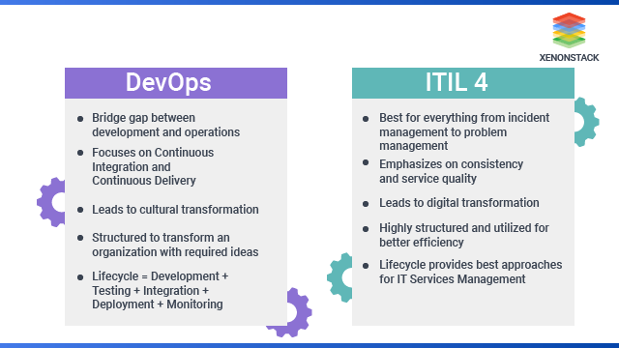
ITIL vs DevOps
Photo by Pixabay

Slide 16

That’s All From Our Side !!
Thank you. Please feel free to ask any questions. 😄

